Slide 1
Anesthesia management for HIPEC
(hyperthermic intraperitoneal chemotherapy)
Dariush Abtahi, MD
Assistant Professor, Imam Hossein Hospital, Department of Anesthesiology, Shahid Beheshti University of Medical Sciences, Tehran, Iran

Slide 3
Heat + cytotoxic drugs act synergistically:
selective destruction of malignant cells: inhibition of RNA synthesis, mitosis arrest
changes in pharmacokinetics/pharmacodynamics of drugs
penetration
action
vascular stasis in the microcirculation of malignant tumors
anaerobic glycolysis/acidosis

Slide 4
“hot chemotherapy” (41–43 °C)
Performed after removing tumors
Effective treatment for peritoneal cancers
pseudomyxoma peritonei
mucinous adenocarcinoma of the appendix
peritoneal mesothelioma
peritoneal metastases from colon cancer
advanced ovarian cancer
⬆︎ 5-year survival in mesothelioma
<10% → 50-90%

Slide 5
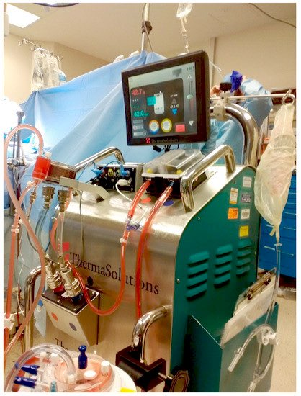
Multiple challenges in anesthesia management
patient’s preoperative health status
disease load
surgical factors - major abdominal surgery
intraoperative events
significant fluid shifts/electrolyte
acid base disturbances
thermal stress
type of chemotherapeutic drug(s)

Slide 6
Preoperative Phase

Slide 7
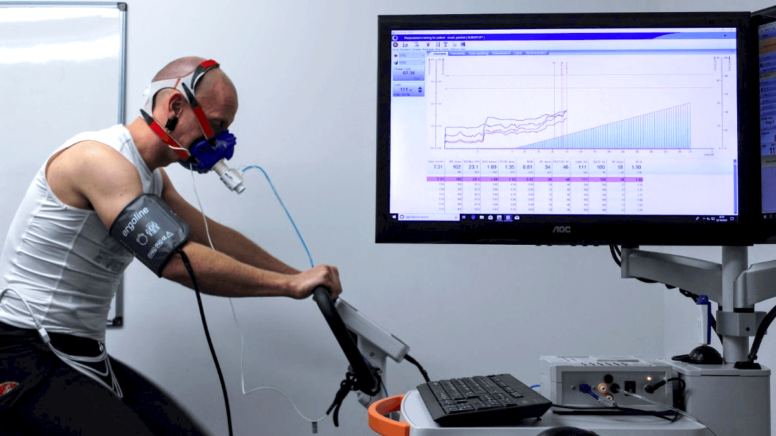
pre-existing cardiac disease
toxic side effects of previous chemotherapy
pre-existing ascites/pleural effusion
atelectasis
postoperative respiratory complications
pulmonary function tests/cardiopulmonary exercise testing (CPET)
FEV1 ≥ 1 L
Poor nutritional status/preoperative hypoalbuminemia/large amounts of ascitic fluid
predictors of major postoperative complications
Hematopoiesis
preoperative anemia should be identified and corrected

Slide 8
Intraoperative Phase

Slide 9
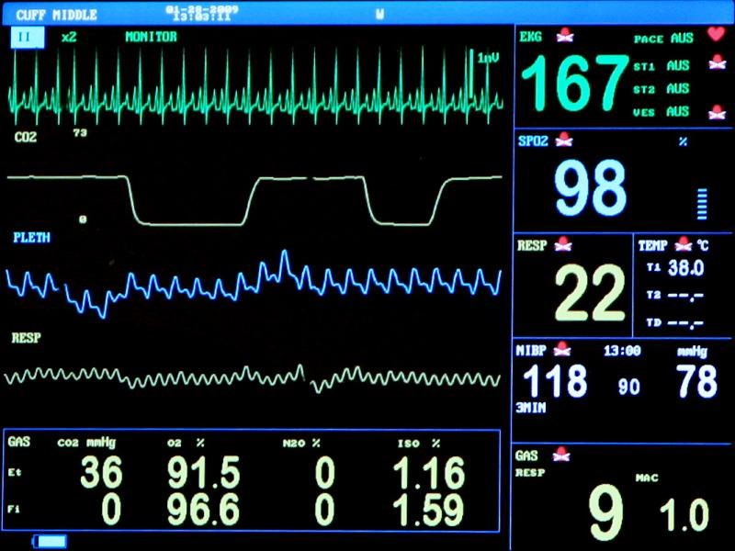
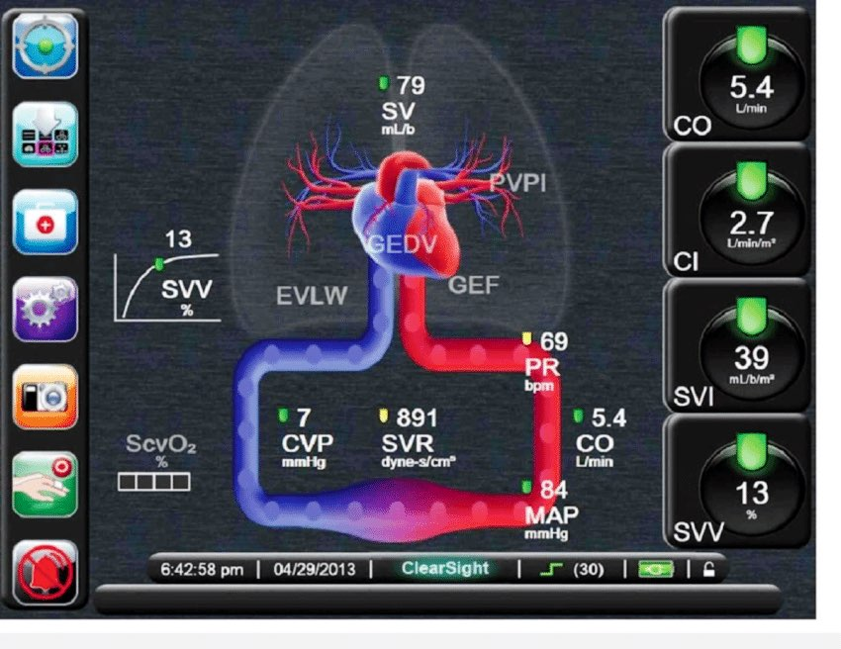
Standard monitoring
SpO2, non-invasive blood pressure, ECG, capnometry, core temperature monitoring
Arterial line placement
blood pressure, blood samples
Invasive functional hemodynamic monitoring
cardiac output measurements
CV line
volume management, administration of vasopressors, postoperative parenteral nutrition
Urinary catheter

Slide 10
General anesthesia with endotracheal intubation
Rapid sequence induction in the presence of abdominal distention
Both inhalational anesthesia and total intravenous anesthesia are suitable.
Lung protective ventilation regime, pre-existing impaired lung function
NG Tube
Baseline labs

Slide 11
Optimizing organ perfusion
more fluid loss (10–12 mL/kg/h) than abdominal surgery (6–8 mL/kg)
⬆︎blood loss during resection stage - blood transfusion in 50% of patients
Removal of the peritoneum + HIPEC → loss of protein- containing exudate
HIPEC phase: vasodilatation/hyperdynamic circulation (⬆︎HR, ⬆︎CO)
HIPEC phase: ⬆︎abdominal pressure → ⬇︎CO (⬇︎venous return)

Slide 12
Crystalloids or colloids?
Substitution regime?
Restrictive fluid use
continuous infusion of vasopressin 0.02 units/h - maintaining urine output at 0.5 mL/kg/h
⬆︎ morbidity and mortality
Liberal volume replacement
edema, cardiopulmonary impairment, complications (anastomotic leakage)

Slide 13
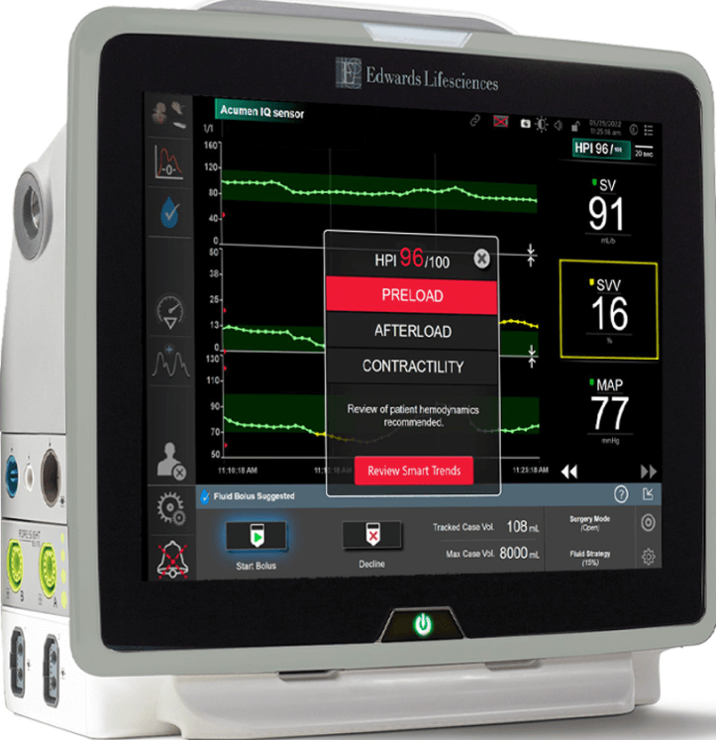
Partially restrictive and goal directed fluid therapy
Volume status – guided by SPV (systolic pressure variation)/PPV ((pulse pressure variation)
Continuous administration (1–2 mL/kg/h) of (balanced) crystalloids
Bolus administration of crystalloids, colloids, blood products
FFP
maintain sufficient oncotic pressure
significant blood loss
Albumin in profound decrease in serum albumin levels
Vasopressor to maintain adequate perfusion pressure

Slide 14
Disturbances in electrolyte balance
Chemotherapy agents
hypomagnesemia
hyperglycemia
abnormalities in calcium/potassium levels
Instilled fluid solution (glucose 5%/Ringer’s solution) → hyponatremia/hyperglycemia
⬆︎ lactate up to 4 times: volume losses, ⬆︎temperature, hypermetabolism

Slide 15
Coagulation disorders
Preexisting coagulation disorders (malnutrition, hypoalbuminemia, ascites)
Coagulation disturbances: ⬆︎INR, ⬇︎Antithrombin III (ATIII) values, ⬆︎aPTT, ⬇︎fibrinogen values
Other issues: volume shifts, protein loss, variations in temperature, blood loss, dilution
Thromboelastography (TEG)/rotational thromboelastography (ROTEM)
stabilize within 24–48 h following surgery
recover within the first 5 postoperative days

Slide 16
Exploratory LAP/CRS
Regional analgesia
Hypothermia
extensive surgical resection
volume loss
duration of surgery
Warm fluids/convective warming systems/⬆︎operating room temperature
Appropriate urine output

Slide 17
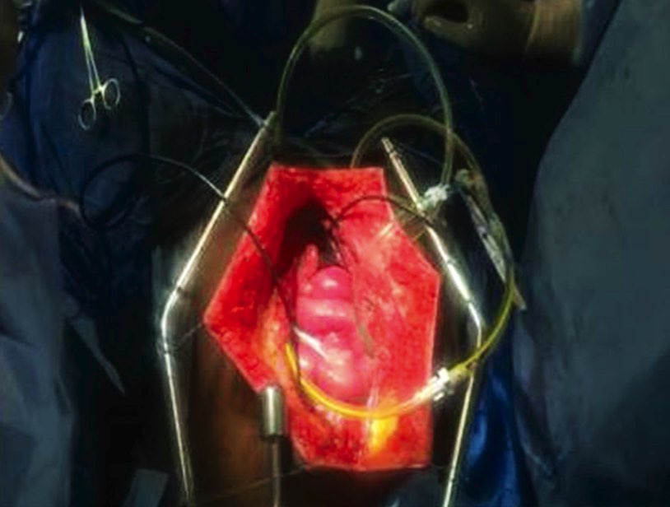
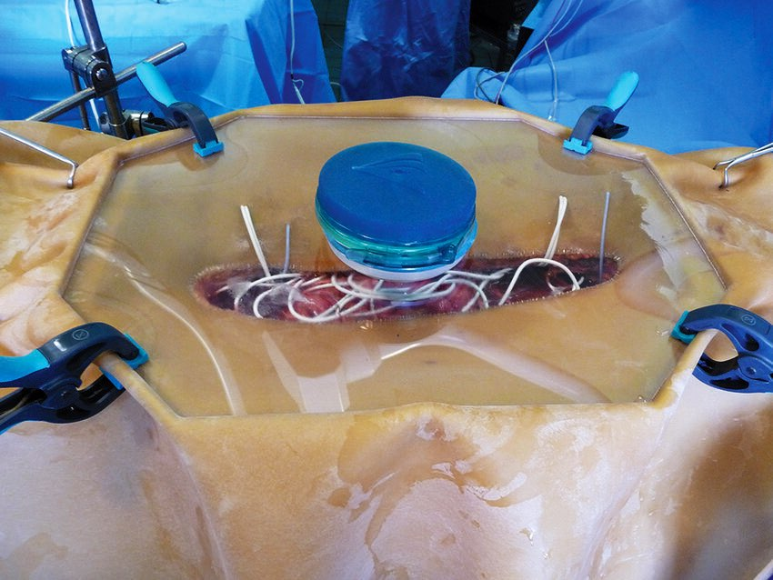
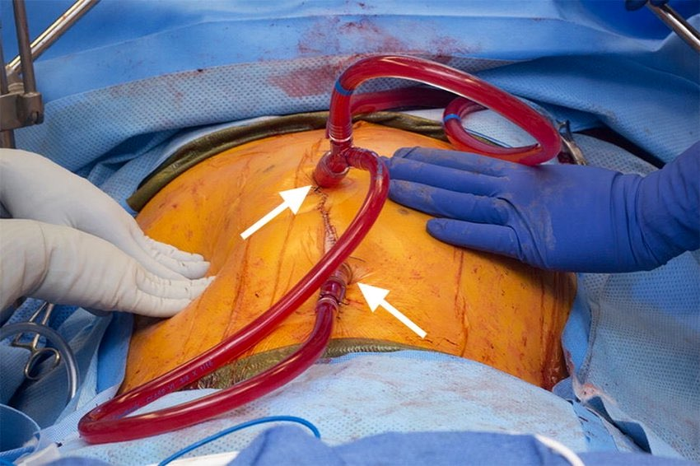
HIPEC
Cranial movement of the diaphragm during the perfusion phase
⬆︎airway pressures
⬇︎functional residual capacity (FRC)
⬆︎oxygen consumption
hyper-metabolic state→⬆︎minute volume
Evaluate/correct labs:
Preemptive use of FFPs/Cryo (guided by TEG)
Re-evaluate need for central line access
Optimize/assure O2 supply/tissue perfusion
Open abdomen technique “Coliseum technique”
Peritoneal cavity expander (PCE)
Closed technique

Slide 18
HIPEC
⬆︎ body temperature (as high as 40.5 °C, mean 37.7°C)
peripheral vasodilation
hyper-metabolic phase
⬆︎oxygen demand
hyperdynamic circulation
The aim in this phase is to restore normothermia
cold IV infusions
ice packs
cooling blanket
⬇︎temperature of the instilled fluid solution

Slide 19
Renal Injury
⬆︎ risk of renal injury
changes in hemodynamics, hyperthermia, chemotherapy
Estimating the absolute lack of intravascular volume and renal function remains difficult.
target urinary output
0.5 mL/kg/h during cytoreduction
1–2 mL/kg/h during HIPEC phase
1–2 mL/kg/h post-HIPEC
Routine use of furosemide to improve urinary output (prevent AKI) is not recommended.

Slide 20
Safety Precautions
Chemotherapeutic drugs
common adverse effects: allergic reactions, nausea, vomiting
specific side effects: nephrotoxicity (the most common)
Cisplatin
direct cardiotoxic effect, prolongation of the QT-interval
selective renal magnesium wasting

Slide 21
Safety Precautions
⬆︎production of aerosols/vapors of chemotherapy drugs at high temperatures
Intraoperative intraperitoneal chemotherapy: safe for patients/staff
High risk groups (pregnant women, breast-feeding mothers, those who are planning pregnancy): advised not to take part in the HIPEC team
Chemotherapeutics are excreted by urine/sweat

Slide 22
Reconstructive/Closing/End
Normalization of ventilation/oxygenation within 30 min after the end of HIPEC
Monitor/maintain acceptable lab levels (including TEG)
Establish/maintain normothermia
Monitor/maintain fluid responsiveness/urine output – guided by SPV/PPV
Monitor/maintain acceptable O2 supply/tissue perfusion
Evaluate need for post-op ventilation

Slide 23
Pain Management
Already using opioids to manage pain caused by tumor masses
Surgical injuries + chemotherapy agents → central/peripheral inflammation → central/peripheral pain
Conventional analgesics (NSAIDs/opioids) → little effects
Management analgesics (opioids) + regional nerve blocks/TEA
Adequate pain management:
early extubation/mobilization
⬇︎ postoperative pulmonary complications

Slide 24
Pain Management
Epidural analgesia
hemodynamic disturbance
Considering coagulation abnormalities
PCA (patient controlled analgesia) containing opioids
Others
single/continuous paravertebral block
subcostal transversus abdominis plane (TAP) block
TAP block will replace thoracic epidural analgesia

Slide 25
Post-operative Phase

Slide 26
Instability/complications
Median ventilation time 3.7 hours
Early extubation
Postoperative respiratory complications → ascites, pleural effusion, atelectasis
Vasopressor support
Average duration of ICU admission 1–2 days

Slide 27
Close monitoring and management for
fluid balance
Urine, nasogastric, drain fluid loss
fluid loss during the first 72 h after surgery: up to 4 L
coagulation profile
electrolytes

Slide 28
Slow return of bowel function:
extensive intraoperative bowel manipulation
lysis of adhesions
intraoperative fluid resuscitation
additive effects of hyperthermia + chemotherapy
Early enteral/parenteral nutrition
AKI is common - 18.4%
Temporary ⬆︎ serum creatinine- the incidence of permanent renal dysfunction is low.
Attention should be directed toward monitoring magnesium levels after HIPEC.

Slide 29
Stress Ulcer Prophylaxis
Hematological toxicity in 10–28% of patients
Risk of developing thrombosis
Heparin / low molecular weight heparin (LMWH)
Mechanical devices
intermittent pneumatic compression
compression stockings

Slide 30
Post-operative Phase
Infectious complications
immunosuppression
antibiotic therapy
peritoneal inflammation
inflammatory response
Leading cause of mortality:
septic shock
Multiple Organ System Failure

Slide 31
One More Thing…

Slide 32
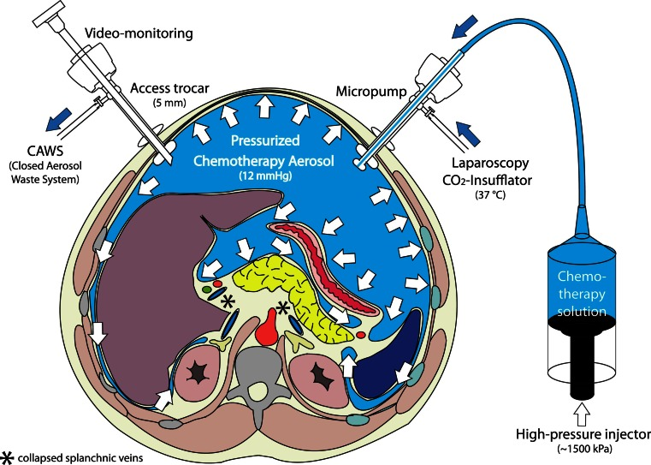
Laparoscopy-Enhanced HIPEC (LE-HIPEC) technique
Pressurized intraperitoneal aerosol chemotherapy (PIPAC)

Slide 33
References
https://www.mdanderson.org/treatment-options/hyperthermic-intraperitoneal-chemotherapy.html
https://health.ucsd.edu/care/cancer/treatments/chemotherapy/HIPEC/
https://www.hopkinsmedicine.org/health/treatment-tests-and-therapies/hipec-surgery-what-you-need-to-know
https://link.springer.com/chapter/10.1007/978-3-030-64739-1_38
https://www.uptodate.com/contents/anesthesia-for-cytoreductive-surgery-with-heated-intraperitoneal-chemotherapy
https://www.sciencedirect.com/science/article/pii/S074879832030665X
https://anesthesia.ucsf.edu/clinical-resources/hyperthermic-intraperitoneal-chemotherapy-hipec
https://journals.plos.org/plosone/article?id=10.1371/journal.pone.0137364
https://pubs.asahq.org/anesthesiology/article/131/6/1367/108775/Preload-Dependence-and-Microcirculation
https://www.sciencedirect.com/science/article/pii/S0104001421002992
https://www.ncbi.nlm.nih.gov/pmc/articles/PMC5881316/
https://wjso.biomedcentral.com/articles/10.1186/s12957-020-01842-7
https://wjso.biomedcentral.com/articles/10.1186/1477-7819-9-169
https://anesthesia.ucsf.edu/clinical-resources/hyperthermic-intraperitoneal-chemotherapy-hipec
https://link.springer.com/article/10.1007/s13193-016-0511-7

Slide 34
